Slide 1
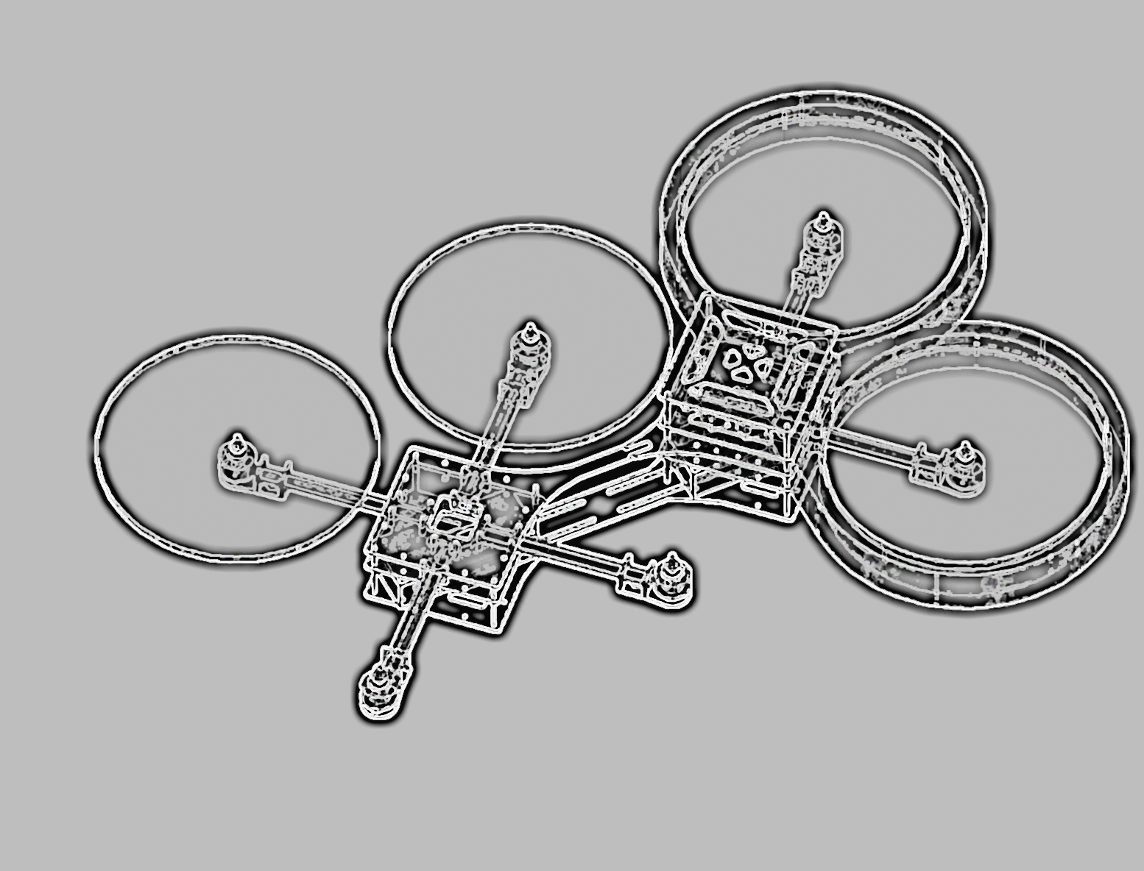
Integrated Project
X-COPTER

Slide 2

The X-Copter Project: Introduction
University of
Applied Sciences
Topic
TEXTtextTEXT

Slide 3
The X-Copter Project: Table of Content
University of
Applied Sciences
Table of Content
Project Management
System Architecture
Hardware
Linux
Flight Controller
Conclusion
Challenges
Lessons Learned

Slide 4
The X-Copter Project: Table of Content
University of
Applied Sciences
Table of Content
Project Management
System Architecture
Hardware
Linux
Flight Controller
Conclusion
Challenges
Lessons Learned

Slide 5
The X-Copter Project: Table of Content
University of
Applied Sciences
Table of Content
Project Management
System Architecture
Hardware
Linux
Flight Controller
Conclusion
Challenges
Lessons Learned

Slide 6
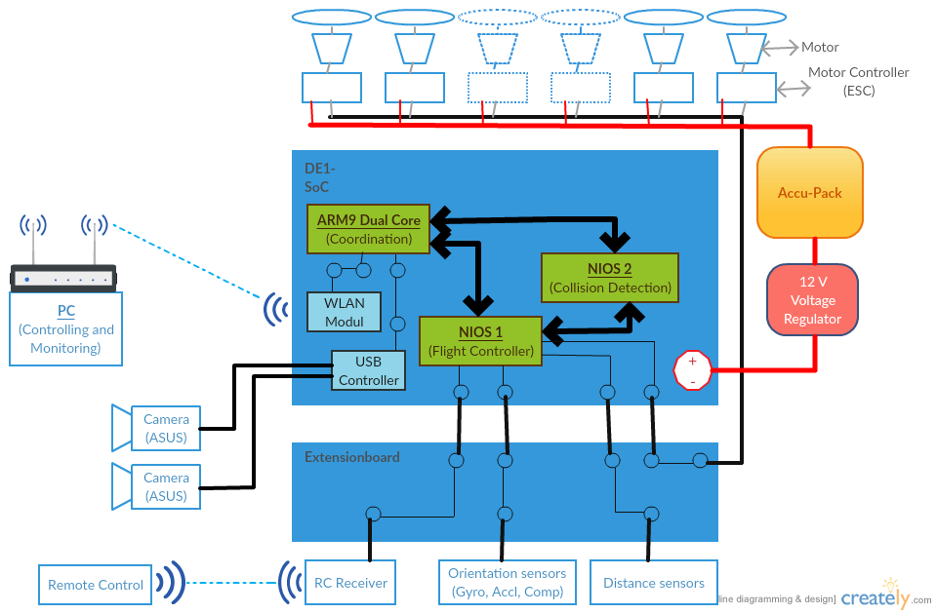
System Architecture

Slide 7
The X-Copter Project: Table of Content
University of
Applied Sciences
Table of Content
Project Management
System Architecture
Hardware
Linux
Flight Controller
Conclusion
Challenges
Lessons Learned

Slide 8
The X-Copter Project: Table of Content
University of
Applied Sciences
Table of Content
Project Management
System Architecture
Hardware
Linux
Flight Controller
Conclusion
Challenges
Lessons Learned

Slide 9
The X-Copter Project: Linux
University of
Applied Sciences
Buildroot
TEXTtextTEXT

Slide 10
The X-Copter Project: Linux
University of
Applied Sciences
Wi-Fi
TEXTtextTEXT

Slide 11
The X-Copter Project: Linux
University of
Applied Sciences
MCAPI
TEXTtextTEXT

Slide 12
The X-Copter Project: Linux
University of
Applied Sciences
MAVLink
TEXTtextTEXT

Slide 13
The X-Copter Project: Table of Content
University of
Applied Sciences
Table of Content
Project Management
System Architecture
Hardware
Linux
Flight Controller
Conclusion
Challenges
Lessons Learned

Slide 14
The X-Copter Project: Table of Content
University of
Applied Sciences
Table of Content
Project Management
System Architecture
Hardware
Linux
Flight Controller
Conclusion
Challenges
Lessons Learned

Slide 15
The X-Copter Project: Table of Content
University of
Applied Sciences
Table of Content
Project Management
System Architecture
Hardware
Linux
Flight Controller
Conclusion
Challenges
Lessons Learned

Slide 16
The X-Copter Project: Table of Content
University of
Applied Sciences
Table of Content
Project Management
System Architecture
Hardware
Linux
Flight Controller
Conclusion
Challenges
Lessons Learned

Slide 17
The X-Copter Project: Topic
University of
Applied Sciences
Topic
TEXTtextTEXT

